Slide 1

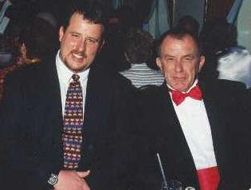
Exposure Java 2013
APCS Edition
Chapter 5 Slides
Control Structures
PowerPoint Presentation
created by:
Mr. John L. M. Schram
and Mr. Leon Schram
Authors of Exposure Java

Slide 2
Section 5.1
Introduction

Slide 3
Program Flow
Program Flow follows the exact sequence of listed program statements, unless directed otherwise by a Java control structure.

Slide 4
Section 5.2
Types of
Control Structures

Slide 5
Types of Control Structures
Simple Sequence
Selection also called:
- Decision Making
- Conditional Branching
- Alternation
Repetition also called:
- Looping
- Iteration

Slide 6
Simple Sequence
Program Statement
Program Statement
Program Statement
Program Statement

Slide 7
One-Way Selection
Program Statement
True
Condition
Program Statement
False
Program Statement
Program Statement

Slide 8
Two-Way Selection
Program Statement
True
Condition
False
Program Statement
Program Statement
Program Statement
Program Statement

Slide 9
Multiple-Way Selection
Selection Variable
Match
Selection Constant
Program Statement
No Match
Match
Selection Constant
Program Statement
No Match
Match
Selection Constant
Program Statement
No Match
Program Statement

Slide 10
Repetition
Program Statement
Program Statement
Program Statement
True
Condition
False
Program Statement

Slide 11
Conditional Statement Definition
A conditional statement is a program expression that evaluates to true or false.
Most conditional statements require a relational operator.
All conditions must be placed inside (parentheses).

Slide 12
Section 5.3
Relational
Operators

Slide 13
Relational Operators
Name | Operator | Expression | Evaluates
Equals | == | 5 == 5 5 == 10 | true false
Not Equals | != | 50 != 25 100 != 100 | true false
Less than | < | 100 < 200 200 < 100 | true false
Greater than | > | 200 > 100 200 > 200 | true false
Less than or equals | <= | 100 <= 200 200 <= 200 200 <= 100 | true true false
Greater than or equals | >= | 100 >= 200 200 >= 200 200 >= 100 | false true true

Slide 14
Important Note:
The relational operators shown on the previous slide will be used in the Java example programs that demonstrate the different control structures.
Be careful not to confuse the equality operator ( = = ) with the assignment operator ( = ).
Before we demonstrate Control Structures, we will look at a few examples of Program Input to make the Control Structures examples more meaningful.

Slide 15
Section 5.4
Keyboard
Input

Slide 16
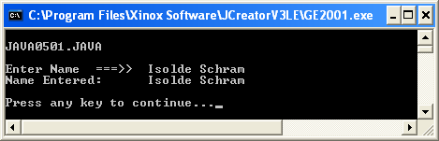
// Java0501.java
// This program demonstrates user keyboard input during program
// execution.
// Many program features will be used that will be explained later.
import java.util.Scanner; // Line 1
public class Java0501
{
public static void main (String args[])
{
Scanner input = new Scanner(System.in); // Line 2
System.out.println("\nJAVA0501.JAVA\n");
System.out.print("Enter name ===>> "); // Line 3
String name = input.nextLine(); // Line 4
System.out.println("Name Entered: " + name);
System.out.println();
}
}

Slide 17
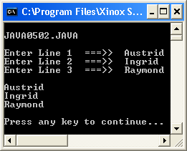
// Java0502.java
// This program demonstrates how to use <nextLine> for three separate String
// keyboard inputs.
import java.util.Scanner;
public class Java0502
{
public static void main (String args[])
{
System.out.println("\nJAVA0502.JAVA\n");
Scanner input = new Scanner(System.in);
System.out.print("Enter Line 1 ===>> ");
String input1 = input.nextLine();
System.out.print("Enter Line 2 ===>> ");
String input2 = input.nextLine();
System.out.print("Enter Line 3 ===>> ");
String input3 = input.nextLine();
System.out.println();
System.out.println(input1);
System.out.println(input2);
System.out.println(input3);
System.out.println();
}
}

Slide 18
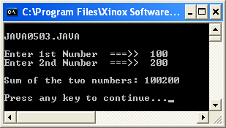
// Java0503.java
// This program demonstrates <String> objects concatenation with
// keyboard entered data.
import java.util.Scanner;
public class Java0503
{
public static void main (String args[])
{
System.out.println("\nJAVA0503.JAVA\n");
Scanner input = new Scanner(System.in);
System.out.print("Enter 1st Number ===>> ");
String number1 = input.nextLine();
System.out.print("Enter 2nd Number ===>> ");
String number2 = input.nextLine();
String sum = number1 + number2;
System.out.println();
System.out.println(number1 + " + " + number2 + " = " + sum);
System.out.println();
}
}

Slide 19
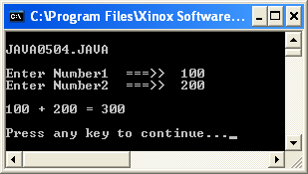
// Java0504.java
// This program uses the <nextInt> method to enter integers from the keyboard.
// It is now possible to correctly add the two numbers.
import java.util.Scanner;
public class Java0504
{
public static void main (String args[])
{
System.out.println("\nJAVA0504.JAVA\n");
Scanner input = new Scanner(System.in);
System.out.print("Enter 1st Number ===>> ");
int number1 = input.nextInt();
System.out.print("Enter 2nd Number ===>> ");
int number2 = input.nextInt();
int sum = number1 + number2;
System.out.println(); System.out.println(number1 + " + " + number2 + " = " + sum);
System.out.println();
}
}

Slide 20
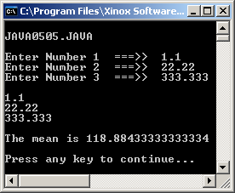
// Java0505.java
// This program demonstrates how to use <nextDouble> for three separate double
// keyboard inputs, which are used to display the mean.
import java.util.Scanner;
public class Java0505
{
public static void main (String args[])
{
System.out.println("\nJAVA0505.JAVA\n");
Scanner input = new Scanner(System.in);
System.out.print("Enter Number 1 ===>> ");
double n1 = input.nextDouble();
System.out.print("Enter Number 2 ===>> ");
double n2 = input.nextDouble();
System.out.print("Enter Number 3 ===>> ");
double n3 = input.nextDouble();
System.out.println();
System.out.println(n1);
System.out.println(n2);
System.out.println(n3);
double mean = (n1+n2+n3)/3;
System.out.println();
System.out.println("The mean is " + mean);
System.out.println();
}
}

Slide 21
Scanner class Input Methods
nextLine() is used to enter string information.
nextInt() is used to enter integer information.
nextDouble() is used to enter real# information.

Slide 22
Section 5.5
Selection

Slide 23
// Java0506.java
// This program demonstrates one-way selection with <if>.
// Run the program twice.
// First with Sales equals to 300,000 and a second time with Sales equals 500,000.
import java.util.Scanner;
public class Java0506
{
public static void main (String args[])
{
System.out.println("\nJAVA0506.JAVA\n");
Scanner keyboard = new Scanner(System.in);
System.out.print("Enter Sales ===>> ");
double sales = keyboard.nextDouble();
double bonus = 250.00;
if (sales >= 500000.0)
bonus += 500.0;
System.out.println("Yearly bonus: " + bonus);
System.out.println();
}
}
This does not have to be the word "input".
It is merely a variable and can be anything.

Slide 24
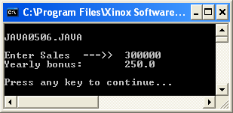

// Java0506.java
// This program demonstrates one-way selection with <if>.
// Run the program twice.
// First with Sales equals to 300,000 and a second time with Sales equals 500,000.
import java.util.Scanner;
public class Java0506
{
public static void main (String args[])
{
System.out.println("\nJAVA0506.JAVA\n");
Scanner keyboard = new Scanner(System.in);
System.out.print("Enter Sales ===>> ");
double sales = keyboard.nextDouble();
double bonus = 250.00;
if (sales >= 500000.0)
bonus += 500.0;
System.out.println("Yearly bonus: " + bonus);
System.out.println();
}
}

Slide 25
Indentation Rule:
Java syntax uses freeform program style. Program statements may be placed on multiple lines with or without indentation.
By convention, control structures and their conditional statements are placed on one line. The program statement that is executed, if the condition is true, is placed on the next line, and indented below the conditional statement.
The preferred way
if(Sales >= 500000)
Bonus += 500;
if(Sales >=500000) Bonus += 500;

Slide 26
Important Note:
Headings are NOT program statements and therefore do not get a semicolon!
This applies to class headings and method headings.
It also applies to
control structure
headings!

Slide 27
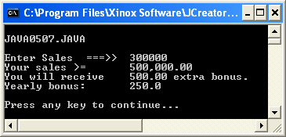

// Java0507.java
// This program demonstrates one-way selection with <if>.
// It also shows that only one statement is controlled.
// Run the program twice. First with Sales equals to 300,000
// and then a second time with Sales equals to 500,000.
import java.util.Scanner;
public class Java0507
{
public static void main (String args[])
{
System.out.println("\nJAVA0507.JAVA\n");
Scanner keyboard = new Scanner(System.in);
System.out.print("Enter Sales ===>> ");
Double sales = keyboard.nextDouble();
double bonus = 250.00;
if (sales >= 500000.0)
bonus += 500.0;
System.out.println("Your sales >= 500,000.00");
System.out.println("You will receive 500.00 extra bonus.");
System.out.println ("Yearly bonus: " + bonus);
System.out.println();
}
}

Slide 28

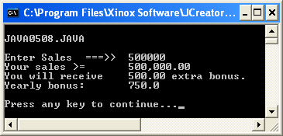
// Java0508.java
// This program demonstrates one-way selection with <if>. It fixes the
// logic problem of the previous program with block structure by using braces.
import java.util.Scanner;
public class Java0508
{
public static void main (String args[])
{
System.out.println("\nJAVA0508.JAVA\n");
Scanner keyboard = new Scanner(System.in);
System.out.print("Enter Sales ===>> ");
double sales = keyboard.nextDouble();
double bonus = 250.00;
if (sales >= 500000.0)
{
bonus += 500.0;
System.out.println("Your sales >= 500,000.00");
System.out.println("You will receive 500.00 extra bonus.");
}
System.out.println("Yearly bonus: " + bonus);
System.out.println();
}
}

Slide 29
One-Way Selection
General Syntax:
if (condition true)
execute program statement
Specific Examples:
if (counter > 100)
System.out.println("Counter exceeds 100");
if (savings >= 10000)
{
System.out.println("It’s skiing time");
System.out.println("Let’s pack");
System.out.println("Remember your skis");
}

Slide 30


Section 5.6
Two Way
Selection

Slide 31
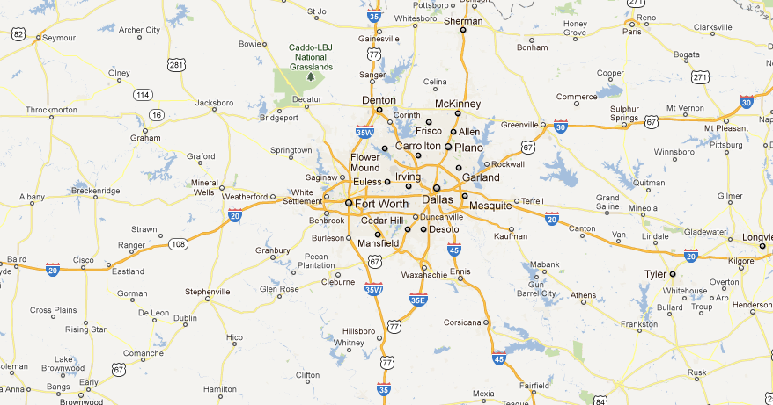
Two-Way Selection Real Life Example
I35W takes you to Fort Worth.
I35E takes you to Dallas.
Interstate 35 splits into I35W and I35E just North of Hillsboro.

Slide 32
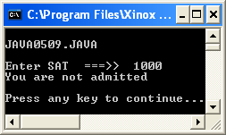
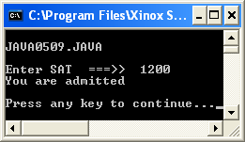
// Java0509.java
// This program demonstrates two-way selection with <if..else>.
import java.util.Scanner;
public class Java0509
{
public static void main (String args[])
{
System.out.println("\nJAVA0509.JAVA\n");
Scanner keyboard = new Scanner(System.in);
System.out.print("Enter SAT ===>> ");
int sat = keyboard.nextInt();
if (sat >= 1100)
System.out.println("You are admitted");
else
System.out.println("You are not admitted");
System.out.println();
}
}

Slide 33
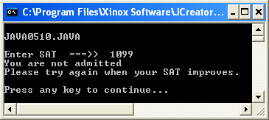
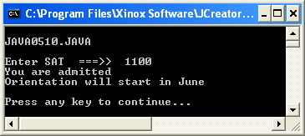
// Java0510.java
// This program demonstrates two-way selection with <if..else>.
// Multiple statements require the use of block structure.
import java.util.Scanner
public class Java0510
{
public static void main (String args[])
{
System.out.println("\nJAVA0510.JAVA\n");
Scanner keyboard = new Scanner(System.in);
System.out.print("Enter SAT ===>> ");
int sat = keyboard.nextInt();
if (sat >= 1100)
{
System.out.println("You are admitted");
System.out.println("Orientation will start in June");
}
else
{
System.out.println("You are not admitted");
System.out.println("Please try again when your SAT improves.");
}
System.out.println();
}
}

Slide 34

Two-Way Selection
General Syntax:
if (condition true)
execute first program statement
else // when condition is false
execute second program statement
Specific Example:
if (gpa >= 90.0)
System.out.println ("You’re an honor graduate");
else
System.out.println ("You’re not an honor graduate");

Slide 35

Section 5.7
Multi Way
Selection

Slide 36

Multi-Way Selection Real Life Example

Slide 37
// Java0511.java
// This program demonstrates multi-way selection with <switch> and <case>.
// This program compiles, but displays illogical output.
import java.util.Scanner;
public class Java0511
{
public static void main (String args[])
{
System.out.println("\nJAVA0511.JAVA\n");
Scanner keyboard = new Scanner(System.in);
System.out.print("Enter Month Number ===>> ");
int month = keyboard.nextInt();
System.out.println();
switch (month)
{
case 1 : System.out.println("January");
case 2 : System.out.println("February");
case 3 : System.out.println("March");
case 4 : System.out.println("April");
case 5 : System.out.println("May");
case 6 : System.out.println("June");
case 7 : System.out.println("July");
case 8 : System.out.println("August");
case 9 : System.out.println("September");
case 10 : System.out.println("October");
case 11 : System.out.println("November");
case 12 : System.out.println("December");
}
System.out.println();
}
}

Slide 38
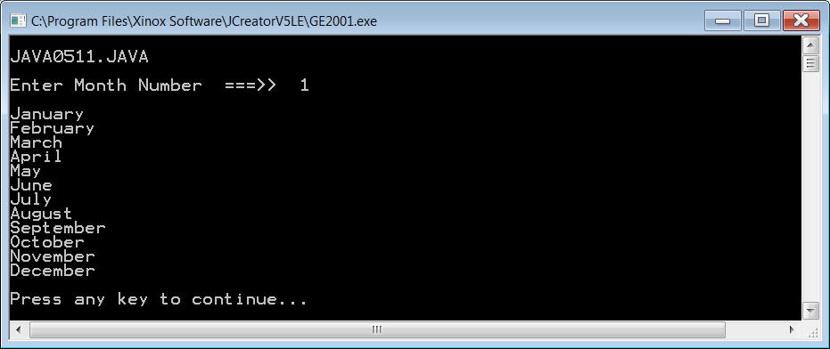
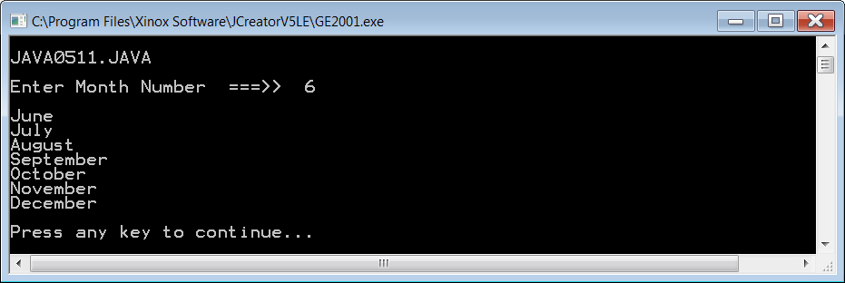
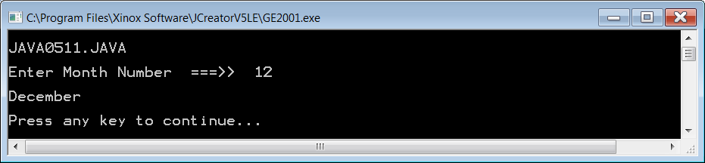

Slide 39
// Java0512.java
// This program demonstrates multi-way selection with <switch> and <case>.
// This program adds <break> and <default>. The use of <break> is required for logical output.
import java.util.Scanner;
public class Java0512
{
public static void main (String args[])
{
System.out.println("\nJAVA0512.JAVA\n");
Scanner keyboard = new Scanner(System.in);
System.out.print("Enter Month Number {1-12} ===>> ");
int month = keyboard.nextInt();
System.out.println();
switch (month)
{
case 1 : System.out.println("January"); break;
case 2 : System.out.println("February"); break;
case 3 : System.out.println("March"); break;
case 4 : System.out.println("April"); break;
case 5 : System.out.println("May"); break;
case 6 : System.out.println("June"); break;
case 7 : System.out.println("July"); break;
case 8 : System.out.println("August"); break;
case 9 : System.out.println("September"); break;
case 10 : System.out.println("October"); break;
case 11 : System.out.println("November"); break;
case 12 : System.out.println("December"); break;
default : System.out.println("This is not a valid month number.");
}
System.out.println();
}
}

Slide 40
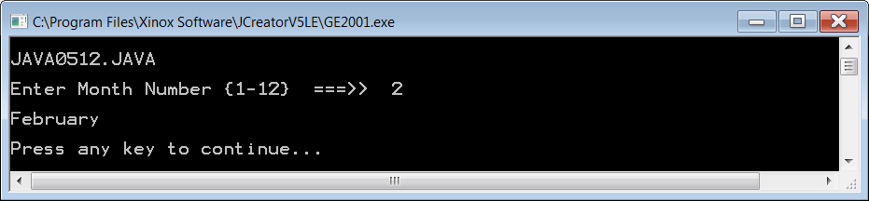
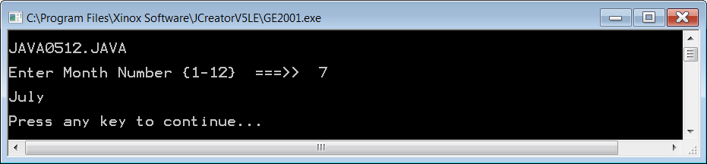
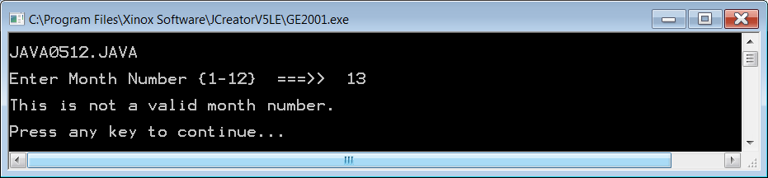

Slide 41
Java 7.0 Warning
The next 2 program examples use a String selection variable with switch.
This will only compile and execute if your JDK (Java Development Kit)
is version 7.0 or newer.

Slide 42
// Java0513.java
// This program demonstrates <switch> used with the <String> data type.
// This requires the uses of the Java 7.0 or later.
// It also shows that multiple program statements can be placed
// between the <case> and <break> commands.
// This is the one time {braces} are NOT used to control multiple statements.
import java.util.Scanner;
public class Java0513
{
public static void main (String args[])
{
System.out.println("\nJAVA0513.JAVA\n");
Scanner input = new Scanner(System.in);
System.out.print("Enter a day abbreviation, like (Sun, Mon, Tue, etc.) ===>> ");
String day = input.nextLine();
System.out.println();
switch (day)
{
case "Sun" :
System.out.println("Sunday");
System.out.println("No School");
break;
case "Mon" :
System.out.println("Monday");
System.out.println("School Day");
break;

Slide 43
case "Tue" :
System.out.println("Tuesday");
System.out.println("School Day");
break;
case "Wed" :
System.out.println("Wednesday");
System.out.println("School Day");
break;
case "Thu" :
System.out.println("Thursday");
System.out.println("School Day");
break;
case "Fri" :
System.out.println("Friday");
System.out.println("School Day");
break;
case "Sat" :
System.out.println("Saturday");
System.out.println("No School");
break;
default : System.out.println("This is not a day of the week.");
}
System.out.println();
}
}

Slide 44
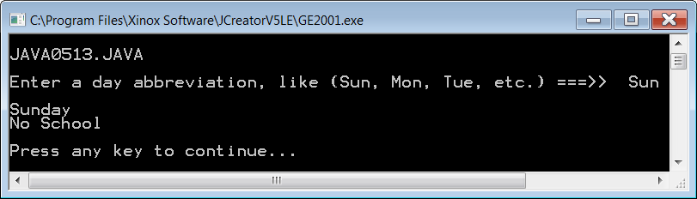
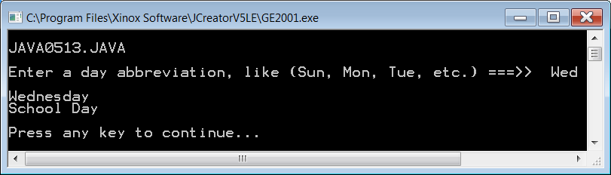
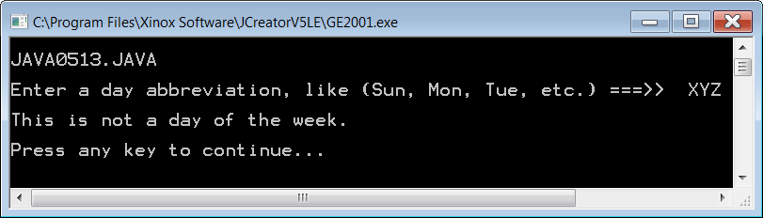

Slide 45

Program Note
In order to focus on the important and relevant parts of each program, several programs will not be shown in their entirety. Rather, a segment of the program will be shown that focuses on the key point. You have the complete programs on your computer.

Slide 46
// Java0514.java
// This <String> example shows a more complex use of the <switch> structure,
// which can handle multiple matches for the same output.
System.out.print("Enter the first name of someone in Leon Schram's family. ===>> ");
String firstName = input.nextLine();
switch (firstName)
{
case "Isolde" :
System.out.println("This is Mr. Schram's wife.");
break;
case "John" :
case "Greg" :
System.out.println("This is one of Mr. Schram's sons.");
break;
case "Maria" :
case "Heidi" :
System.out.println("This is one of Mr. Schram's daughters.");
break;
case "Mike" :
case "David" :
System.out.println("This is one of Mr. Schram's sons-in-law.");
break;

Slide 47
case "Diana" :
System.out.println("This is Mr. Schram's daughter-in-law.");
break;
case "Jessica" :
case "Haley" :
case "Brenda" :
case "Mari" :
System.out.println("This is one of Mr. Schram's granddaughters.");
break;
case "Anthony" :
case "Alec" :
case "Maddox" :
case "Jaxon" :
case "Braxton" :
System.out.println("This is one of Mr. Schram's grandsons.");
break;
case "Austrid" :
case "Ingrid" :
System.out.println("This is one of Mr. Schram's sisters.");
break;
case "Remy" :
System.out.println("This is Mr. Schram's brother.");
break;

Slide 48
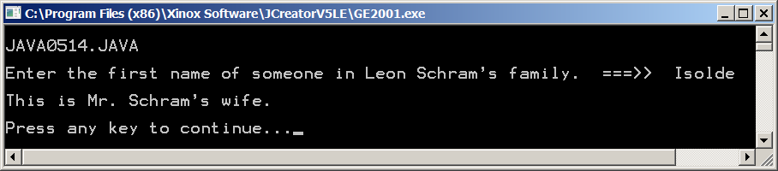
case "Darlene" :
case "Kassi" :
case "Holli" :
System.out.println("This is one of Mr. Schram's nieces.");
break;
case "Gene" :
case "Sean" :
case "Blake" :
System.out.println("This is one of Mr. Schram's nephews.");
break;
default :
System.out.println("This is not someone in Mr. Schram's immediate family.");
System.out.println("Make sure you spell the name correctly and only capitalize the first letter.");
}

Slide 49
Multiple-Way Selection General Syntax
switch(selectionVariable)
{
case selectionConstant :
program statement;
program statement;
: : :
break;
case selectionConstant :
program statement;
program statement;
: : :
break;
default
program statement;
program statement;
: : :
}

Slide 50
Multiple-Way Selection Specific Example
switch(courseGrade)
{
case 'A' : points = 4; break;
case 'B' : points = 3; break;
case 'C' : points = 2; break;
case 'D' : points = 1; break;
case 'F' : points = 0; break;
default : System.out.println("Error");
}
The default statement is used to handle the situation when a proper match is not found. Frequently an error message is used to indicate that no match was found.

Slide 51

Section 5.8
Fixed
Repetition

Slide 52
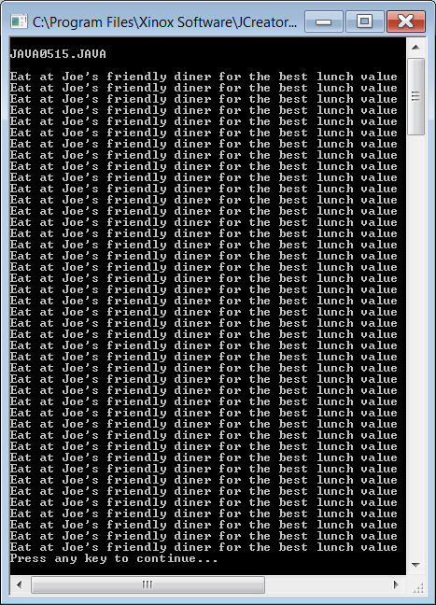
// Java0515.java
// This program displays 40 identical lines very inefficiently
// with 40 separate println statements.
public class Java0515
{
public static void main(String args[])
{
System.out.println("\nJAVA0515.JAVA\n");
System.out.println("Eat at Joe's friendly diner for the best lunch value");
System.out.println("Eat at Joe's friendly diner for the best lunch value");
System.out.println("Eat at Joe's friendly diner for the best lunch value");
System.out.println("Eat at Joe's friendly diner for the best lunch value");
System.out.println("Eat at Joe's friendly diner for the best lunch value");
System.out.println("Eat at Joe's friendly diner for the best lunch value");
System.out.println("Eat at Joe's friendly diner for the best lunch value");
System.out.println("Eat at Joe's friendly diner for the best lunch value");
System.out.println("Eat at Joe's friendly diner for the best lunch value");
System.out.println("Eat at Joe's friendly diner for the best lunch value");
System.out.println("Eat at Joe's friendly diner for the best lunch value");
System.out.println("Eat at Joe's friendly diner for the best lunch value");
System.out.println("Eat at Joe's friendly diner for the best lunch value");
System.out.println("Eat at Joe's friendly diner for the best lunch value");
System.out.println("Eat at Joe's friendly diner for the best lunch value");
: : : : : : : : : : : : : : : :

Slide 53
// Java0516.java
// This program displays 40 identical lines efficiently
// with one println statement and a loop structure.
public class Java0516
{
public static void main(String args[])
{
System.out.println("\nJAVA0516.JAVA\n");
int k;
for (k = 1; k <= 40; k++)
System.out.println("Eat at Joe's friendly diner for the best lunch value");
}
}
What if you
want to display
the message
100 or 1000 or
1 million times?
Output is the same as
the previous program.

Slide 54
// Java0516.java
// This program displays 40 identical lines efficiently
// with one println statement and a loop structure.
public class Java0516
{
public static void main(String args[])
{
System.out.println("\nJAVA0516.JAVA\n");
int k;
for (k = 1; k <= 40; k++)
System.out.println("Eat at Joe's friendly diner for the best lunch value");
}
}
Another look
at the 3 parts
of a for loop
Part 1 is used to initialize the counter
(Loop Control Variable).

Slide 55
// Java0516.java
// This program displays 40 identical lines efficiently
// with one println statement and a loop structure.
public class Java0516
{
public static void main(String args[])
{
System.out.println("\nJAVA0516.JAVA\n");
int k;
for (k = 1; k <= 40; k++)
System.out.println("Eat at Joe's friendly diner for the best lunch value");
}
}
Another look
at the 3 parts
of a for loop
Part 1 is used to initialize the counter
(Loop Control Variable).
Part 2 is a condition. As long as it is true the loop will keep repeating.

Slide 56
// Java0516.java
// This program displays 40 identical lines efficiently
// with one println statement and a loop structure.
public class Java0516
{
public static void main(String args[])
{
System.out.println("\nJAVA0516.JAVA\n");
int k;
for (k = 1; k <= 40; k++)
System.out.println("Eat at Joe's friendly diner for the best lunch value");
}
}
Another look
at the 3 parts
of a for loop
Part 1 is used to initialize the counter
(Loop Control Variable).
Part 2 is a condition. As long as it is true the loop will keep repeating.
Part 3 indicates what the counter counts by. ++ means count by 1.

Slide 57
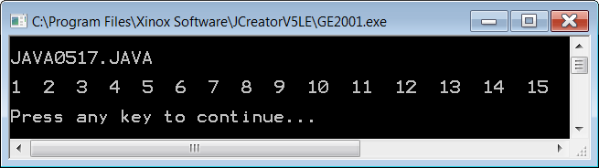
// Java0517.java
// This program displays consecutive numbers 1 through 15.
// It also shows how the loop control variable may be
// defined inside the <for> program statement.
public class Java0517
{
public static void main(String args[])
{
System.out.println("\nJAVA0517.JAVA\n");
for (int k = 1; k <= 15; k++)
System.out.print(k + " ");
System.out.println();
}
}

Slide 58
Defining the Loop Control Variable
Before the loop heading (not used much)
Inside the loop heading (preferred approach)
int k;
for (k = 1; k <= 10; k++)
{
System.out.println("Hello World");
}
for (int k = 1; k <= 10; k++)
{
System.out.println("Hello World");
}

Slide 59
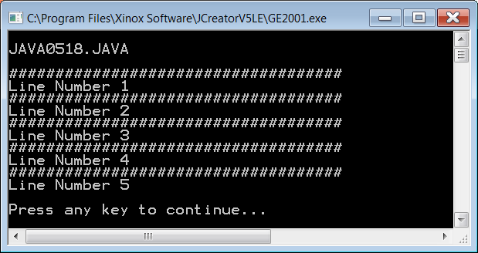
// Java0518.java
// This program demonstrates how to use block structure
// with a <for> loop control structure.
public class Java0518
{
public static void main(String args[])
{
System.out.println("\nJAVA0518.JAVA\n");
for (int k = 1; k <= 5; k++)
{
System.out.println("####################################");
System.out.println("Line Number " + k);
}
System.out.println();
}
}

Slide 60
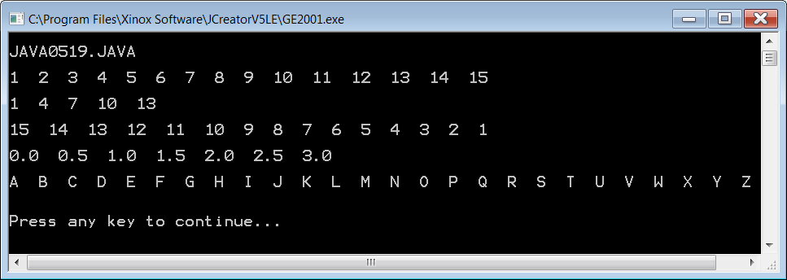
// Java0519.java
// This program displays various counting schemes.
// It also demonstrates the versatility of the <for> loop.
public class Java0519
{
public static void main(String args[])
{
System.out.println("\nJAVA0519.JAVA\n");
for (int p = 1; p <= 15; p++)
System.out.print(p + " ");
System.out.println("\n");
for (int q = 1; q <= 15; q+=3)
System.out.print(q + " ");
System.out.println("\n");
for (int r = 15; r >= 1; r--)
System.out.print(r + " ");
System.out.println("\n");
for (double s = 0; s <= 3; s+=0.5)
System.out.print(s + " ");
System.out.println("\n");
for (char t = 'A'; t <= 'Z'; t++)
System.out.print(t + " ");
System.out.println("\n\n");
}
}
You do NOT always have to use ++ in the 3rd part of a for loop.
You can count by any amount.
You can count backwards.
You can count by fractional amounts.
You can even count with characters.

Slide 61
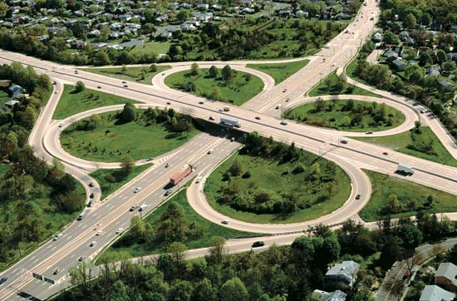
Fixed Repetition
Java has a variety of control structures for repetition.
Other computer science terms for repetition are looping and iteration.
Fixed Repetition is done with the for loop structure.
General Syntax:
The for loop has three distinct parts:
Part1 initializes the Loop Control Variable.
Part2 sets the exit condition for the loop.
Part3 determines how the LCV changes.
Specific Example:
for (Part1; Part2; Part3)
loop body;
for (k = 1; k <= 10; k++)
System.out.println("Java is 10 times more fun");

Slide 62

Section 5.9
Conditional
Repetition

Slide 63
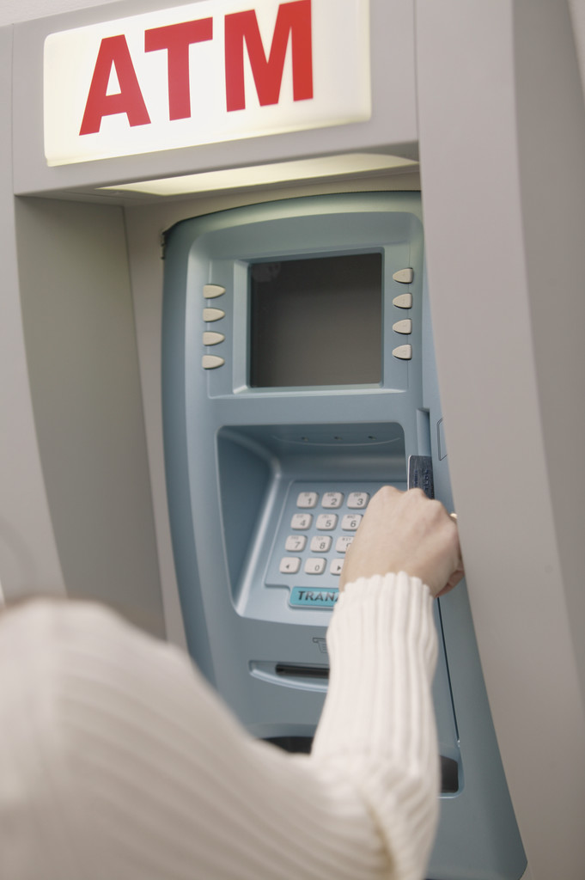

Conditional Repetition Real Life Examples

Slide 64
Note to Students with Advanced Knowledge
It is possible to treat the for loop structure like a conditional loop that is not fixed. In fact, a for loop can be designed to behave exactly like a while loop.
It is my intention to use and treat a for loop like a fixed iteration loop and use the while loop and do...while loop for other repetition situations.
This approach is less likely to cause confusion. At some later date, when you are comfortable with all the control structures, you can use them in any appropriate manner.
If this does not make sense to you, do not worry.
Ignore this little summary box, and move on.

Slide 65
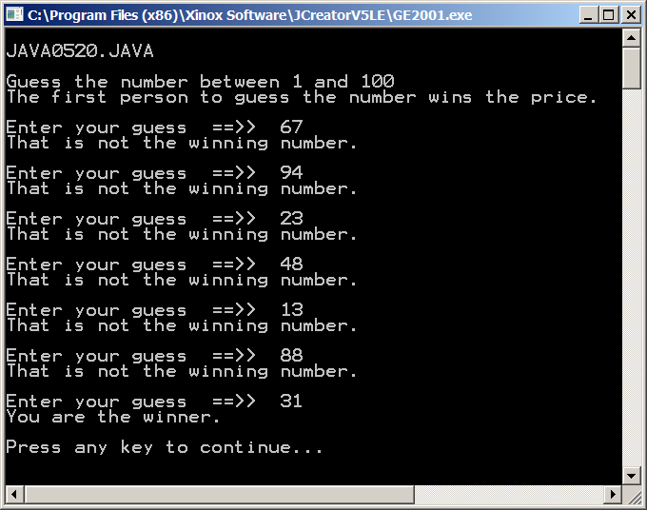
// Java0520.java
// This program demonstrates the precondition <while> loop.
// This loop will continue until the winning number is entered.
// This loop does not repeat in a fixed number of times.
import java.util.Scanner;
public class Java0520
{
public static void main(String args[])
{
System.out.println("\nJAVA0520.JAVA\n");
Scanner input = new Scanner(System.in);
System.out.println("Guess the number between 1 and 100");
System.out.println("The first person to guess the number wins the price.");
System.out.println();
int guess = 0;
while (guess != 31)
{
System.out.print("Enter your guess ==>> ");
guess = input.nextInt();
if (guess == 31)
System.out.println("You are the winner.");
else
System.out.println("That is not the winning number.");
System.out.println();
}
}
}

Slide 66
Pre-Conditional Repetition
General Syntax:
initialize condition variable before the while loop
while(condition is true)
{
loop body
alter condition variable in the loop body
}
Specific Example:
int pin = 0; // initialize condition variable
while(pin != 5678)
{
System.out.print("Enter pin. ===>> ");
pin = input.nextInt(); // alter condition variable
}
System.out.println("Welcome.");

Slide 67
Program Segment NoNo #1 | Program Segment YesYes #1
int x = 0; while(x < 10) System.out.println(x); | int x = 0; while(x < 10) { x++; System.out.println(x); }
The loop condition variable, x, never changes. The loop will not exit. | The loop condition variable, x, changes. The loop exits when x reaches 10.

Slide 68
Program Segment NoNo #2 | Program Segment YesYes #2
int x; while(x < 10) { x++; System.out.println(x); } | int x = 0; while(x < 10) { x++; System.out.println(x); }
The loop condition variable, x, is never initialized. This program will not compile in Java. | The loop condition variable, x, is initialized. The program will compile and execute normally.

Slide 69
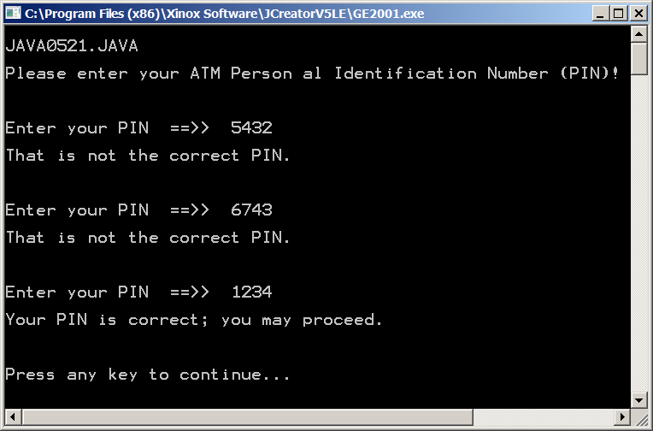
// Java0521.java
// This program demonstrates the postcondition <do..while> loop.
// This loop structure guarantees at least one repetition of the loop body.
// Like the <while> loop this is not a "fixed iteration" loop.
import java.util.Scanner;
public class Java0521
{
public static void main(String args[])
{
System.out.println("\nJAVA0521.JAVA\n");
Scanner input = new Scanner(System.in);
System.out.println("Please enter your ATM Person al Identification Number (PIN)!");
System.out.println("\n\n");
int PIN = 0;
do
{
System.out.print("Enter your PIN ==>> ");
PIN = input.nextInt();
System.out.println();
if (PIN == 1234)
System.out.println("Your PIN is correct; you may proceed.");
else
System.out.println("That is not the correct PIN.");
System.out.println("\n\n");
}
while (PIN != 1234);
}
}

Slide 70
Post-Conditional Repetition
General Syntax:
initialize condition variable before the do..while loop
do
{
loop body
alter condition variable in the loop body
}
while(condition is true)
Specific Example:
int pin = 0; // initialize condition variable
do
{
System.out.print("Enter pin. ===>> ");
pin = input.nextInt(); // alter condition variable
}
while(pin != 5678); // Not a heading, Semicolon is required.
System.out.println("Welcome.");

Slide 71
Fixed Repetition vs. Conditional Repetition
Fixed Repetition describes a situation where you know – ahead of time – how many times you want the loop to repeat.
An example would be drawing exactly 100 circles on the screen.
The command for fixed repetition is for.
Conditional Repetition describes a situation where you do NOT know how many times the loop will repeat.
The loop has to repeat until some condition is met.
An example would be entering a password.
The command for pre-conditional repetition is while.
The commands for post-conditional repetition is do..while.

Slide 72
AP Exam Alert Selection Control Structures
The one-way selection if is tested on the AP Exam.
if (sales >= 500000)
bonus = bonus + 5000.0;
The two-way selection if..else is tested on the AP Exam.
if (sat >= 1200)
System.out.println("You're admitted");
else
System.out.println("You're not admitted");
The multi-way selection switch..case..break is NOT tested on the AP Exam.
switch (grade)
{
case 'A' : gpaPoints = 4; break;
case 'B' : gpaPoints = 3; break;
case 'C' : gpaPoints = 2; break;
case 'D' : gpaPoints = 1; break;
case 'F' : gpaPoints = 0;
}

Slide 73
AP Exam Alert Repetition Control Structures
The fixed-repetition for loop is tested on the AP Exam.
for (int k = 1; k <= max; k++)
sum += k;
The pre-condition while loop is tested on the AP Exam.
while (k < max)
{
sum += k; k++;
}
The post-condition do..while loop is NOT tested on the AP Exam.
do
{
sum += k;
k++;
}
while (k < max);

Slide 74
Section 5.10
Control Structures
with Graphics

Slide 75
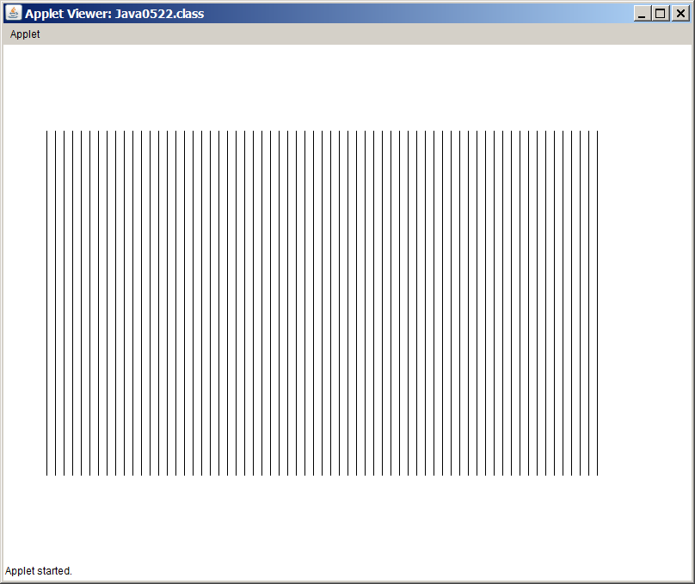
// Java0520.java
// This program shows how a control structure can be used with graphics.
// This program draws vertical lines, because x1 & x2 have the same value.
import java.awt.*;
import java.applet.*;
public class Java0520 extends Applet
{
public void paint(Graphics g)
{
int y1 = 100;
int y2 = 500;
for (int x = 50; x < 700; x +=10)
g.drawLine(x,y1,x,y2);
}
}

Slide 76
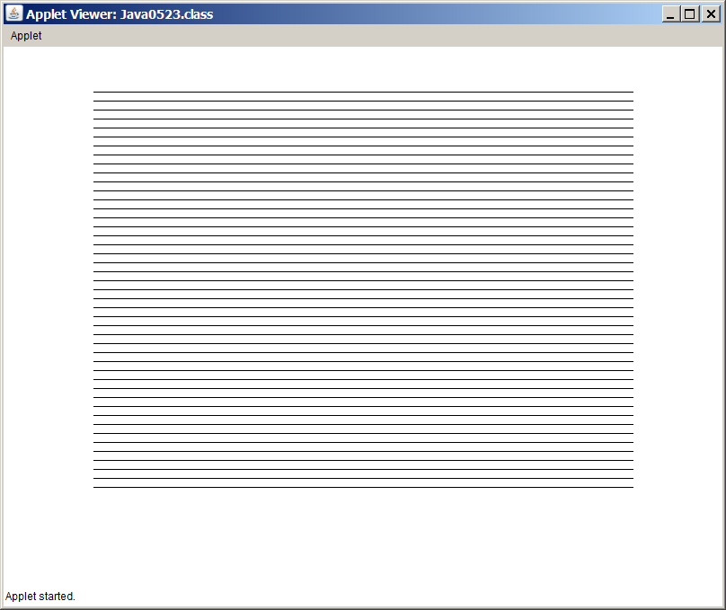
// Java0523.java
// This program shows how a control structure can be used with graphics.
// This program draws horizontal lines, because y1 and y2 have the same
// value.
import java.awt.*;
import java.applet.*;
public class Java0523 extends Applet
{
public void paint(Graphics g)
{
int x1 = 100;
int x2 = 700;
for (int y = 50; y < 500; y +=10)
g.drawLine(x1,y,x2,y);
}
}

Slide 77
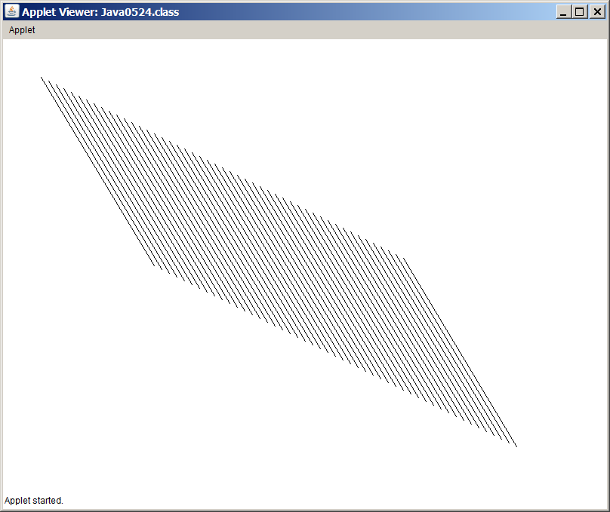
// Java0524.java
// This program shows how a control structure can be used with graphics.
// This program draws diagonal lines, because x1, y1, y2, y2, all four change.
import java.awt.*;
import java.applet.*;
public class Java0524 extends Applet
{
public void paint(Graphics g)
{
int x1 = 50;
int x2 = 200;
int y1 = 50;
int y2 = 300;
for (int k = 1; k < 50; k++)
{
g.drawLine(x1,y1,x2,y2);
x1 += 10;
x2 += 10;
y1 += 5;
y2 += 5;
}
}
}

Slide 78
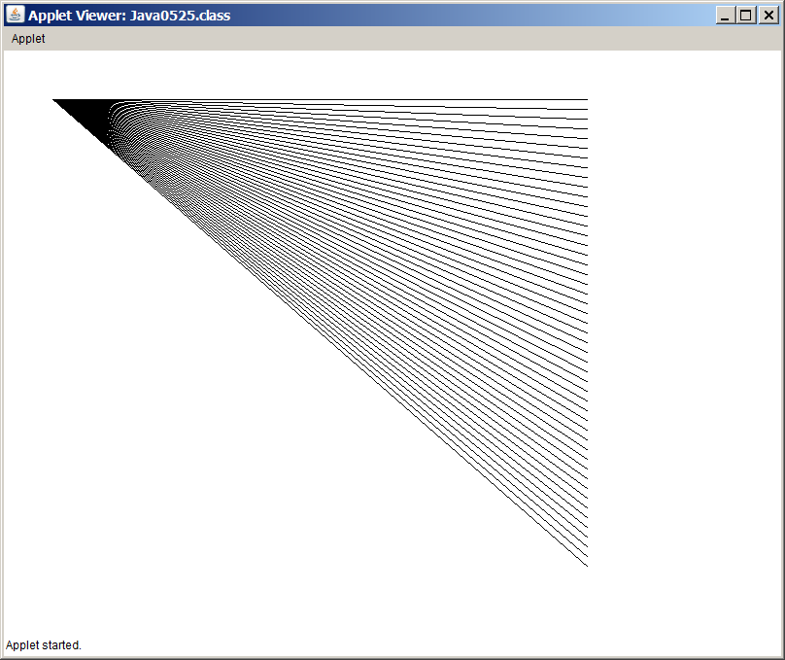
// Java0525.java
// This program demonstrates how to rotate a line around a point.
// In this case the (x1,y1) coordinate stays fixed and the (x2,y2) point changes.
import java.awt.*;
import java.applet.*;
public class Java0525 extends Applet
{
public void paint(Graphics g)
{
int x1 = 50;
int y1 = 50;
int x2 = 600;
int y2 = 50;
for (int k = 1; k < 50; k++)
{
g.drawLine(x1,y1,x2,y2);;
y2 += 10;
}
}
}

Slide 79
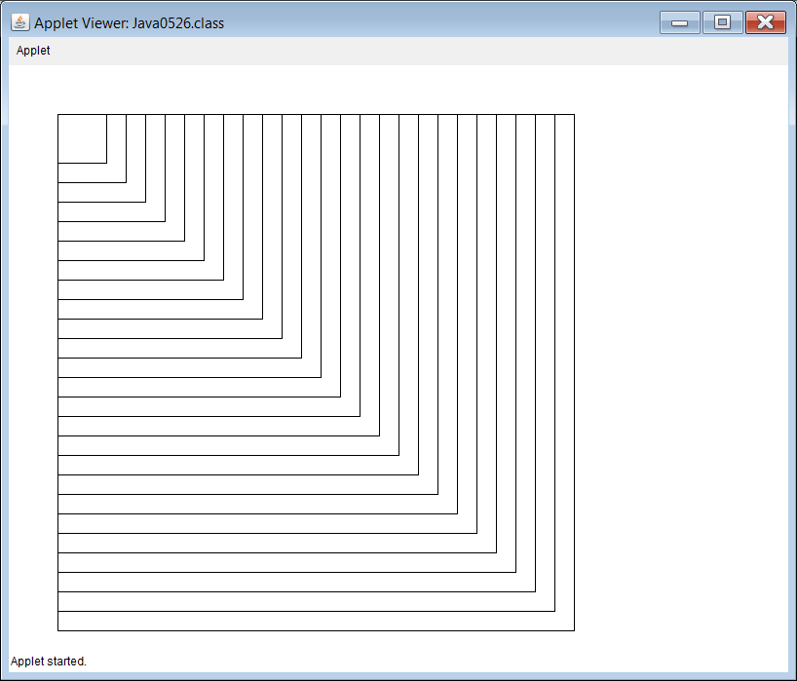
// Java0526.java
// This program is example of displaying multiple graphics rectangles
// using a loop control structure.
// Note how all rectangle share the same top-left corner.
import java.awt.*;
import java.applet.*;
public class Java0526 extends Applet
{
public void paint(Graphics g)
{
int x = 375;
int y = 275;
int side = 50;
for (int k = 1; k <= 25; k++)
{
g.drawRect(50,50,side,side);
side += 20;
}
}
}

Slide 80
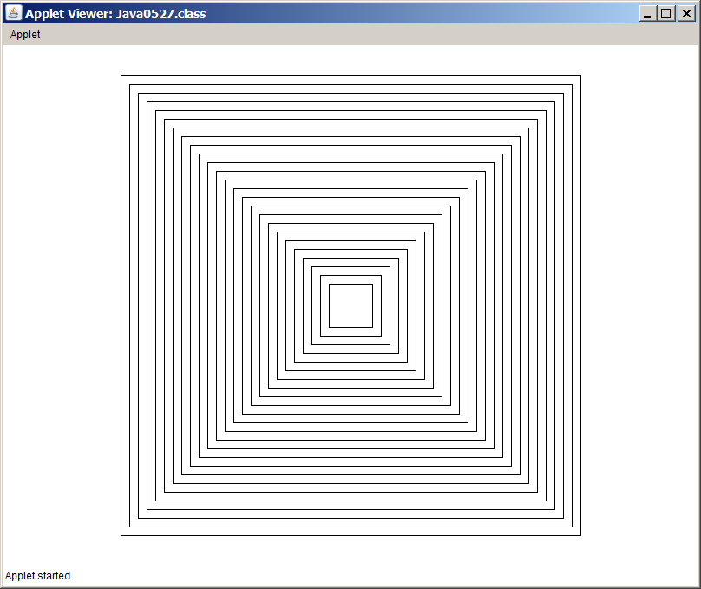
// Java0527.java
// This program is another example of displaying multiple graphics rectangles
// using a loop control structure.
import java.awt.*;
import java.applet.*;
public class Java0527 extends Applet
{
public void paint(Graphics g)
{
int x = 375;
int y = 275;
int side = 50;
for (int k = 1; k <= 25; k++)
{
g.drawRect(x,y,side,side);
x -= 10;
y -= 10;
side += 20;
}
}
}

Slide 81
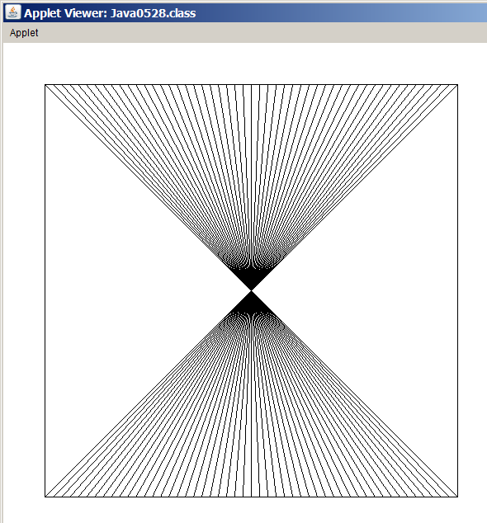
// Java0528.java
// This program demonstrates how to draw multiple lines easily with
// a loop structure inside a rectangle to form a pattern.
import java.awt.*;
import java.applet.*;
public class Java0528 extends Applet
{
public void paint(Graphics g)
{
g.drawRect(50,50,500,500);
for (int x = 50; x <= 550; x += 10)
g.drawLine(x,50,600-x,550);
}
}

Slide 82
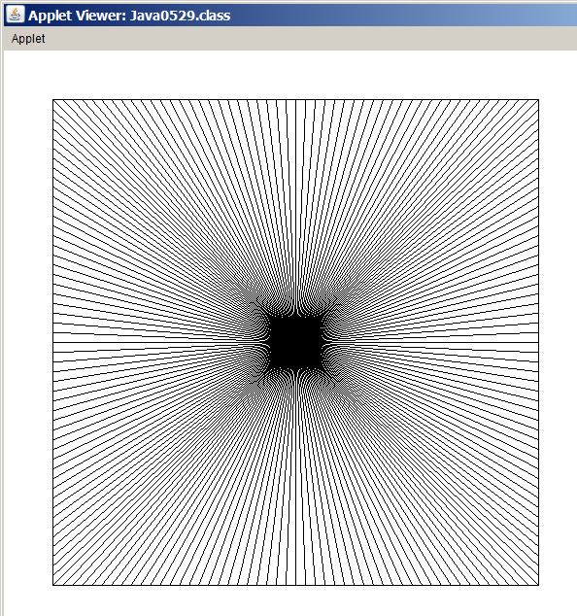
// Java0529.java
// This program continues the pattern started in Java0528.java to
// create an interesting pattern.
import java.awt.*;
import java.applet.*;
public class Java0529 extends Applet
{
public void paint(Graphics g)
{
g.drawRect(50,50,500,500);
for (int x = 50; x <= 550; x += 10)
g.drawLine(x,50,600-x,550);
for (int y = 50; y <= 550; y += 10)
g.drawLine(50,y,550,600-y);
}
}

Slide 83
Section 5.11
GridWorld and
Control Structures

Slide 84
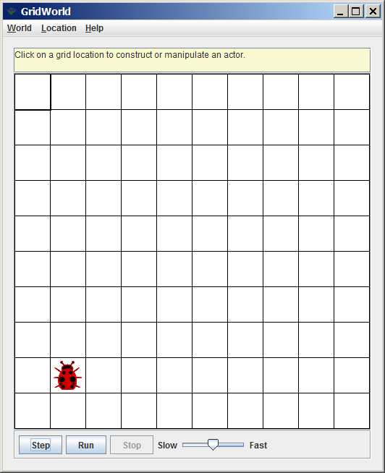
Lab Experiment 0530 Step 01A
Start JCreator.
Click File, New and Project.
Click Empty Project and Next.
Click the Location Browse button and navigate to folder Java0530.
Click OK.
Click Finish twice. (This is not the same as a double click)
Compile (Build) the project.
Execute (Run) the project.

Slide 85
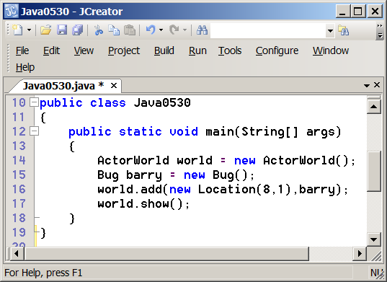
Lab Experiment 0530 Step 01B
Program Java0530.java is shown below and you see the statement Location(8,1), which places the new object at that location. The other statements you see used here will be explained in future chapters.

Slide 86
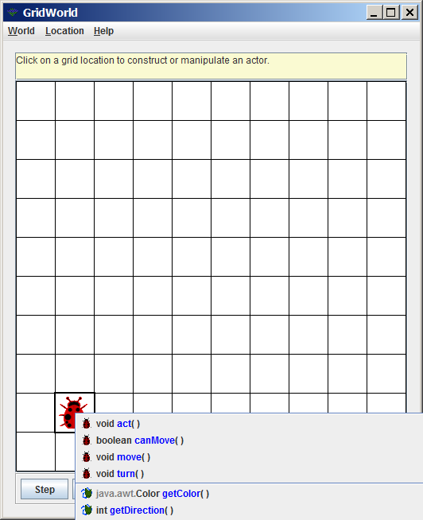
Lab Experiment 0530 Step 02A, 02B & 03
Click on the Bug object. (You will see all the available Bug methods)
Click the move method.
Click on the Bug object then move again.
Click on the Bug object.
Click the turn method. (The bug turns 45 degrees)
On your own create a small
(3 X 3) square.

Slide 87
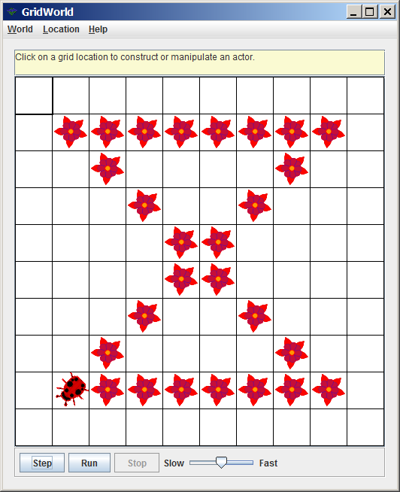
Lab Experiment 0531 Step 01 & 02
Create Project Java0531
Execute Project Java0531
The bug creates a pattern of flowers in the design of an hourglass.

Slide 88
Lab Experiment 0531 – Step 3
ActorWorld world = new ActorWorld();
Bug barry = new Bug();
world.add(new Location(8,1), barry);
world.show();
barry.turn(); barry.turn();
for (int k = 1; k <= 7; k++)
barry.move();
for (int k = 1; k <= 5; k++)
barry.turn();
for (int k = 1; k <= 7; k++)
barry.move();
for (int k = 1; k <= 3; k++)
barry.turn();
for (int k = 1; k <= 7; k++)
barry.move();
for (int k = 1; k <= 3; k++)
barry.turn();
for (int k = 1; k <= 7; k++)
barry.move();
Study this program code.

Slide 89
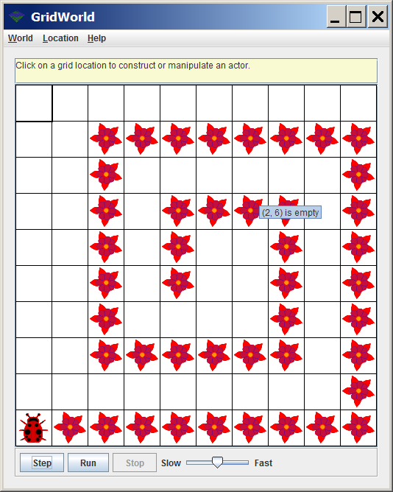
Lab Experiment 0532 Step 01 & 02
Create Project Java0532
Execute Project Java0532
The bug creates a pattern of flowers in the design of a spiral.

Slide 90
Lab Experiment 0532 – Step 3
ActorWorld world = new ActorWorld();
Bug barry = new Bug();
world.add(new Location(5,4),barry);
world.show();
for (int k = 1; k <= 2; k++)
barry.move();
barry.turn(); barry.turn();
for (int k = 1; k <= 3; k++)
barry.move();
barry.turn(); barry.turn();
for (int k = 1; k <= 4; k++)
barry.move();
barry.turn(); barry.turn();
for (int k = 1; k <= 5; k++)
barry.move();
barry.turn(); barry.turn();
for (int k = 1; k <= 6; k++)
barry.move();
barry.turn(); barry.turn();
for (int k = 1; k <= 7; k++)
barry.move();
barry.turn(); barry.turn();
for (int k = 1; k <= 8; k++)
barry.move();
barry.turn(); barry.turn();
for (int k = 1; k <= 9; k++)
barry.move();
barry.turn(); barry.turn();
Study this program code.

Slide 91
Lab Experiment 0532 CHALLENGE
The spiral does use loop structures for efficiency, but there are really too many loop structures.
With a combination of loop structures and decision structures, the program code can be much shorter and create the same exact spiral.
Take some time now and try to alter the program code.

